Slide 1

Anytime fitness
August 2025

Slide 2

DELIVERABLES

Slide 3
Analytic Report

Slide 4
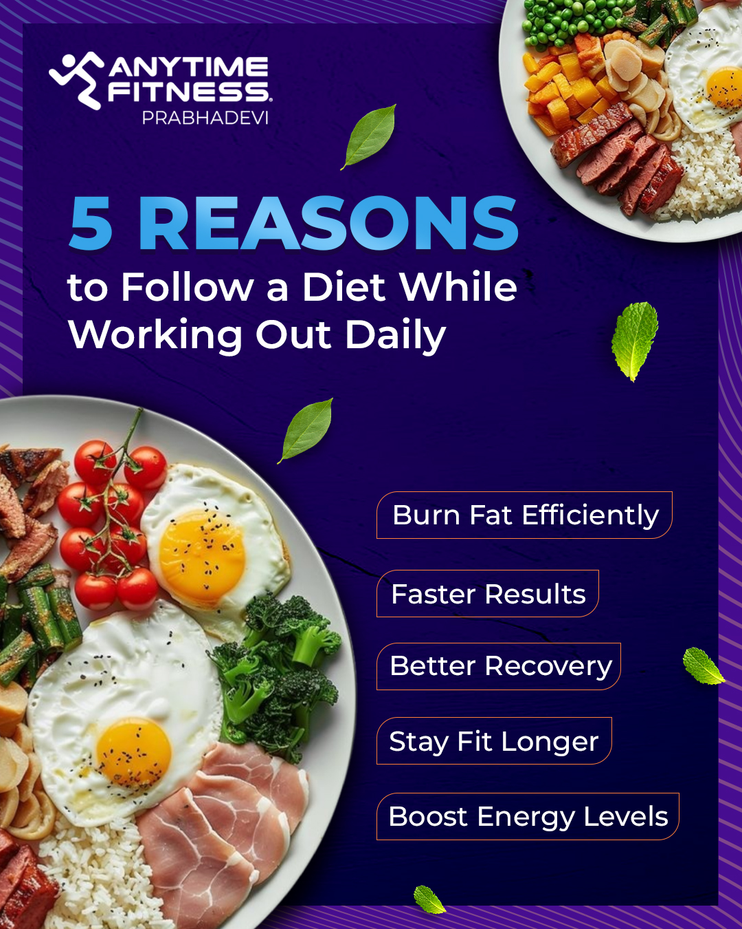

Static Posts
Post 1
05.08.25
Post 2
08.08.25

Slide 5


Static Posts
Post 3
18.08.25
Post 4
27.08.25

Slide 6


Complimentary story and post

Slide 7



AD Creatives

Slide 8
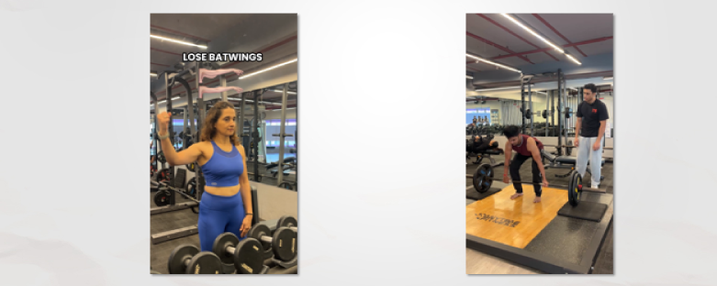
Reels
Reel 1
07.08.25
Reel 2
12.08.25

Slide 9
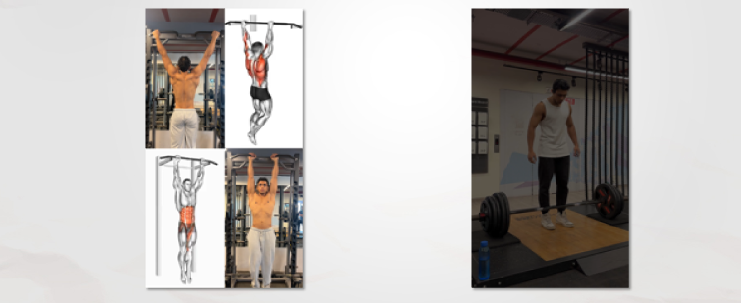
Reels
Reel 3
21.08.25
Reel 4
21.08.25

Slide 10

FB Cover Image

Slide 11
Visits & Followers

Slide 12


